Slide 1
SYSTEMS ANALYSIS AND DESIGN
Nguyen Thanh Binh, Nguyen Quang Vu, Le Viet Truong, Nguyen Thi Hanh, Vo Van Luong, Le Thi Bich Tra
Faculty of Computer Science

Slide 2
Requirements modeling
Requirements determination
Use-case diagrams

Slide 3
Software Development Activities
Requirements Gathering
Define requirement specification
Analysis
Define the conceptual model
Design
Design the solution / software plan
Implementation
Code the system based on the design
Integration and Test
Prove that the system meets the requirements
Deployment
Installation and training
Maintenance
Post-install review
Support docs
Active support

Slide 4
Requirement
The systems development process transforms the existing (as is) system into the proposed (to be) system
Requirements determination
The single most critical step of the entire SDLC
Changes can be made easily in this stage
Most (>50%) system failures are due to problems with requirements
The iterative process of OOSAD is effective because:
Small batches of requirements can be identified and implemented incrementally
The system will evolve over time

Slide 5
Requirements Determination
Purpose: to convert high level business requirements (from the system request) into detailed requirements that can be used as inputs for creating models
What is a requirement?
A statement of what the system must do or a characteristic it must have
Will later evolve into a technical description of how the system will be implemented
Types:
Functional: relates to a process or data
Non-functional: relates to performance or usability

Slide 6
Nonfunctional Requirements
Requirement type | Example
Operational | The system should be able to fit in a pocket or purse The system should be able to integrate with the existing inventory system.
Performance | Any interaction between the user and the system should not exceed 2 seconds. The system should receive updated inventory information every 15 minutes.
Security | Only direct managers can see personnel records of staff Customers can see their order history only during business hours.
Cultural & Political | The system should be able to distinguish between United States and European currency The system shall comply with insurance industry standards.

Slide 7
Requirements Definition
Functional & non-functional requirements listed in outline format
May be prioritized
Provides information needed in subsequent workflows
Defines the scope of the system

Slide 8
Determining Requirements
Business & IT personnel need to collaborate
Strategies for effective results:
Business Process Analysis (BPA)
Business Process Improvement (BPI)
Business Process Reengineering (BPR)

Slide 9
Determining Requirements
Requirements are best determined by systems analysts and business people together
Strategies for analyzing the requirements
Business Process Analysis (BPA)
Business Process Improvement (BPI)
Business Process Reengineering (BPR)
Techniques for identifying requirements
Interviews, questionnaires and/or observation
Joint application development (JAD)
Document analysis

Slide 10
Creating a Requirements Definition
Determine the types of functional and non-functional requirements applicable to the project
Use requirements-gathering techniques to collect details
Analysts work with users to verify, change and prioritize each requirement
Continue this process through analysis workflow, but be careful of scope creep
Requirements that meet a need but are not within the current scope can be added to a list of future enhancements

Slide 11
Problems in Requirements Determination
Analyst may not have access to the correct users
Requirement's specifications may be inadequate
Some requirements may not be known in the beginning
Verifying and validating requirements can be difficult

Slide 12
Requirements Analysis Strategies
Business Process Automation (BPA)
Least amount of change to the current system
Use computer technology to automate some portions
Business Process Improvement (BPI)
Moderate amount of change is required
Designed to improve efficiency of the current system
Business Process Reengineering (BPR)
Most amount of change—a complete makeover
Focus is on the to-be system—little time spent on the current system

Slide 13
Business Process Automation
Techniques
Problem analysis
Ask users to identify problems with the current system
Ask users how they would solve these problems
Good for improving efficiency or ease-of-use
Root cause analysis
Focus is on the cause of a problem, not its solution
Create a prioritized list of problems
Try to determine their causes
Once the causes are known, solutions can be developed

Slide 14
Business Process Improvement
Techniques:
Duration analysis
Determine the time required to complete each step in a business process
Compare this to the total time required for the entire process
Large differences suggest problems that might be solved by:
Integrating some steps together
Performing some steps simultaneously (in parallel)
Activity-based costing—same as duration analysis but applied to costs
Informal benchmarking—analyzes similar processes in other successful organizations

Slide 15
Business Process Reengineering
Institutes maximum change: “Out with the old and in with the new”
Techniques:
Outcome analysis—what does the customer want in the end?
Technology analysis—apply new technologies to business processes & identify benefits
Activity elimination—eliminate each activity in a business process in a “force-fit” exercise

Slide 16
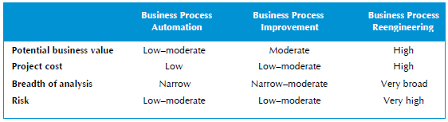
Selecting An Appropriate Strategy

Slide 17
Requirements Gathering Techniques
Process is used to:
Uncover all requirements (those uncovered late in the process are more difficult to incorporate)
Build support and trust among users
Which technique(s) to use?
Interviews
Joint Application Development (JAD)
Questionnaires
Document analysis
Observation

Slide 18
Interviews
Most popular technique—if you need to know something, just ask
Process:
Select people to interview & create a schedule
Design interview questions (Open-ended, closed-ended, & probing types of questions)
Prepare for the interview (Unstructured vs. structured interview organized in a logical order)
Conduct the interview (Top-down vs. bottom-up)
Follow-up after the interview

Slide 19
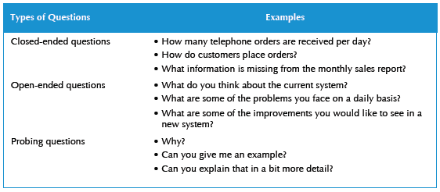
Question Types

Slide 20
Interviewing Strategies
Top-down
How
can order
processing be
improved?
High-level:
Very general
Medium-level:
Moderately specific
How can we reduce the
number of times that customers
return ordered items?
Low-level:
Very specific
How can we reduce the number of
errors in order processing (e.g., shipping
the wrong products)?
Bottom-up

Slide 21
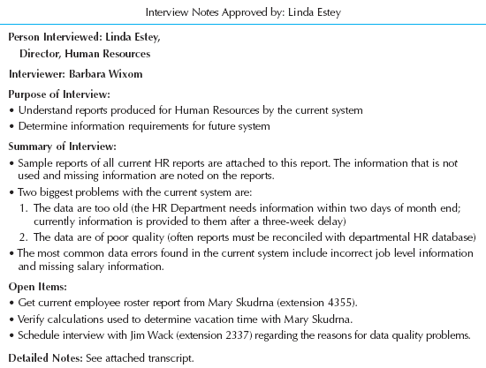
Post-Interview
Prepare notes and send to the interviewee for verification

Slide 22
Joint Application Development (JAD)
Joint user-analyst meeting hosted by a facilitator
10 to 20 users
1 to 2 scribes as needed to record the session
Usually in a specially prepared room
Meetings can be held electronically and anonymously
Reduces problems in group settings
Can be held remotely
Sessions require careful planning to be successful
Users may need to bring documents or user manuals
Ground rules should be established

Slide 23
Questionnaires
A set of written questions used to obtain information from individuals
May be paper based or electronic (e.g., web based)
Common uses:
Large numbers of people
Need both information and opinions
When designing for use outside the organization (customers, vendors, etc.)
Typical response rates: < 50% (paper); < 30% (Web)

Slide 24
Questionnaire Steps
Select the participants
Identify the population
Use representative samples for large populations
Designing the questionnaire
Careful question selection
Remove ambiguities
Administering the questionnaire
Working to get good response rate
Offer an incentive (e.g., a free pen)
Questionnaire follow-up
Send results to participants
Send a thank-you

Slide 25
Good Questionnaire Design
Begin with non-threatening and interesting questions
Group items into logically coherent sections
No important items at the very end
Do not crowd a page with too many items
Avoid abbreviations
Avoid biased or suggestive items or terms
Number questions to avoid confusion
Pretest to identify confusing questions
Provide anonymity to respondents

Slide 26
Document Analysis
Provides information about the “as-is” system
Review technical documents when available
Review typical user documents:
Forms
Reports
Policy manuals
Look for user additions to forms
Look for unused form elements

Slide 27
Observation
Users/managers often don’t remember everything they do
Checks validity of information gathered in other ways
Behaviors may change when people are watched
Workers tend to be very careful when watched
Keep a low profile
Try not to interrupt or influence workers
Be careful not to ignore periodic activities
Weekly … Monthly … Annually

Slide 28
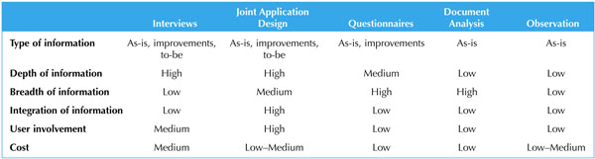
Requirements-Gathering Techniques Compared
A combination of techniques may be used
Document analysis & observation require little training; JAD sessions can be very challenging

Slide 29
Alternative Techniques
Concept Maps
Represent meaningful relationships between concepts
Focus individuals on a small number of key ideas
Story Cards & Task Lists
Associated with agile development methods
File cards with a single requirement
Each requirement is discussed
How much effort is required to implement it
A task list is created for each requirement (story)
Large requirements can be split into smaller sections

Slide 30
The System Proposal
Combines all material created in planning & analysis
Included sections:
Executive summary
Provides all critical information is summary form
Helps busy executives determine which sections they need to read in more detail
The system request
The workplan
The feasibility analysis
The requirements definition
Current models of the system (expected to evolve)

Slide 31
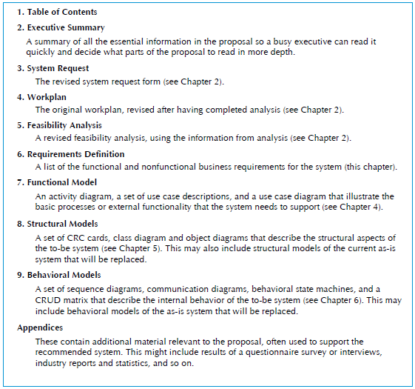
System Proposal Template

Slide 32
Views
Static view
Class diagrams
Object diagrams
Architectural view
Package diagrams
Component diagrams
Users view
Use-case diagrams
Dynamic view
Interaction diagrams
State diagrams
Activity diagrams
Deployment view
Deployment diagrams

Slide 33
Use-case diagram
The first step in requirement analysis is to determine use-cases of the system
Use-case diagrams
allow to represent the functionalities of the system in the users view
allow to delimit the boundary of the system
UserManagement
add user
delete user
admin
<<use>>
find user
modify user

Slide 34
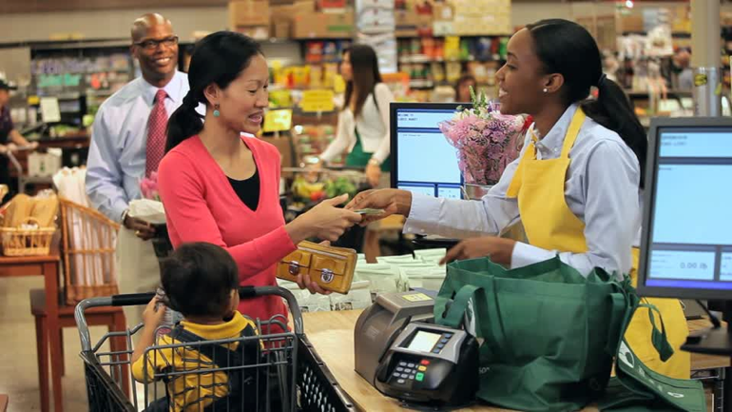
User-centred design
The development of a system should always be centred around the needs of users
Understand who are the users
Understand the tasks performed by the users
Make sure that users are involved in the decision-making process
Design the interface well following the needs of the user
Users will need to evaluate prototypes and return their comments
Cash register at the supermarket

Slide 35
Interest of user-centred design
Meets the actual requirements
Reduce costs related to changes or maintenance
Allow to better define the properties in the development
Reduce learning time
Reduce training and supporting costs
Allow efficient use
Making the system more attractive and better suited to its market

Slide 36
Determining users’ characteristics
Good questions
What are their goals?
How will they use the software?
What is their level of computer literacy?
What are their psychological characteristics?
What are their habits?

Slide 37
Use-case diagrams
A use-case diagram consists of three parts
The system
The use-case
The actor
Graphical representation
« actor »
System
Use-case
Actor
Actor

Slide 38
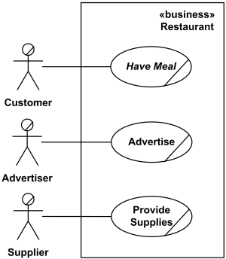
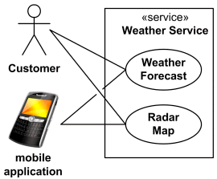
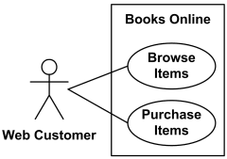
System
The system can be any system, not only the software system
It defines the boundary of the system in a clear and precise manner
Not too ambitious
Only determine basic functionalities
Build a well defined architecture
Additional functionality can be added during development
“Books Online” system
“Restaurant” system
“Weather Service” system

Slide 39
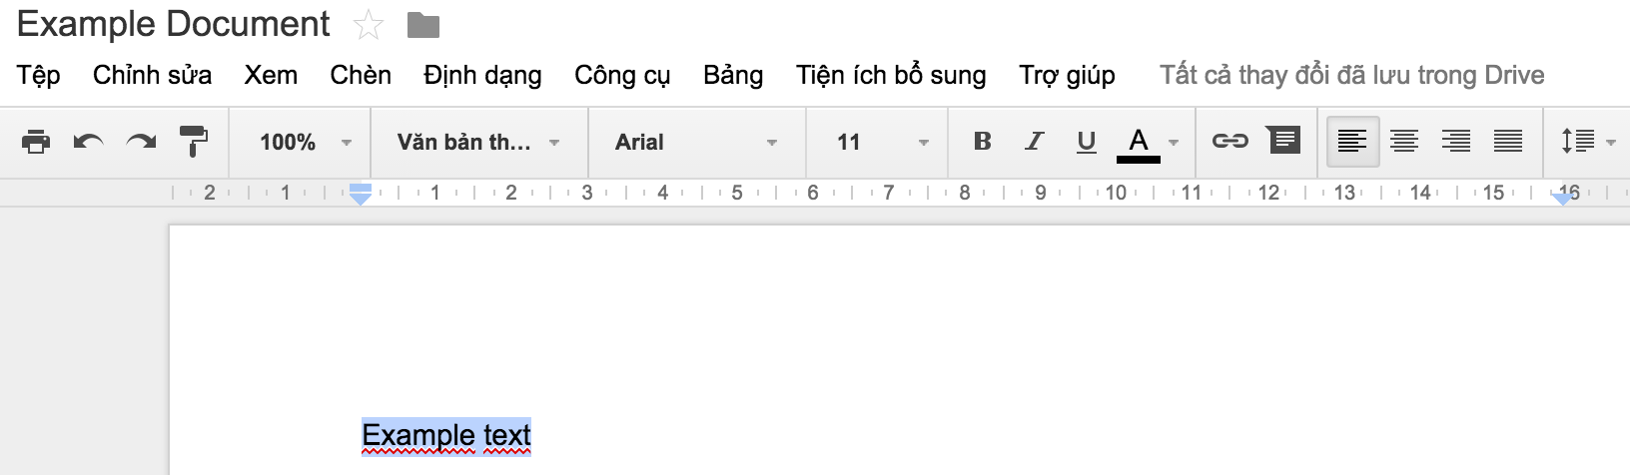
Use-case
A use-case is a typical interaction or a typical sequence of interactions between the system and its environment
The objective of a use-case is to model the system
according to the perspective of user interacting with the system
to accomplish their objectives
A use-case may can be either large or small
Example: developing a tool for text processing, some possible use-cases
Create a new document
Modify an existing documents
Delete a document
Input new text, …
Text processing tool

Slide 40
Use-case
A use-case needs to
always correspond to a high level objective
describe the interaction between the user and the system, not the operations that the system should perform
cover all the steps to follow in performing a given task
be written, to the possible extent, independently of the user interface
include only the interactions with the system

Slide 41
Use-case
Objectives and interactions
Objectives of users: what users expect from the system
Interactions with the system: mechanisms to meet those objectives
Define the objectives then determine the interactions to achieve objectives
Example
Objective: define the document style
Interactions: choose the font, choose sizes, choose the page layout, …

Slide 42
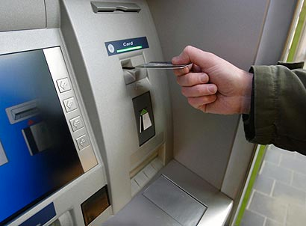
Use-case
Example: developing of an ATM system
Some interactions in the following scenario
Insert the card
Enter the PIN code
Choose the amount to be withdrawn
Confirm the amount
Take the card
Take the money
Take the receipt
Is each interaction a use-case?

Slide 43
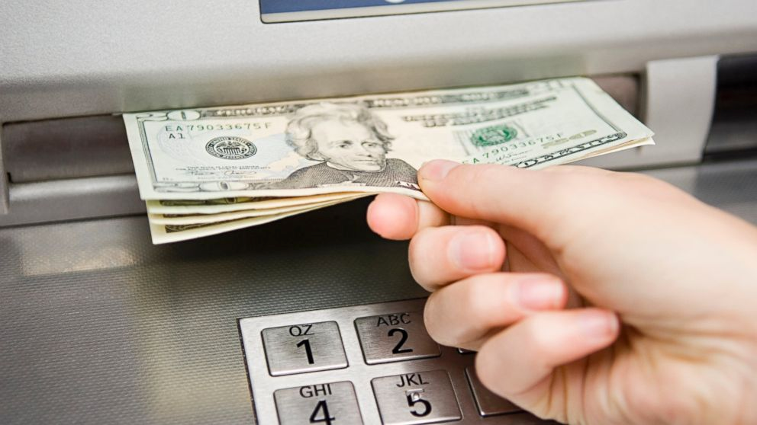
Use-case
Example (continue)
The answer is no
Since some interactions such as “confirm the amount” do not meet a goal of the user
The goal of the user in this case is to withdraw money: this is a use-case

Slide 44
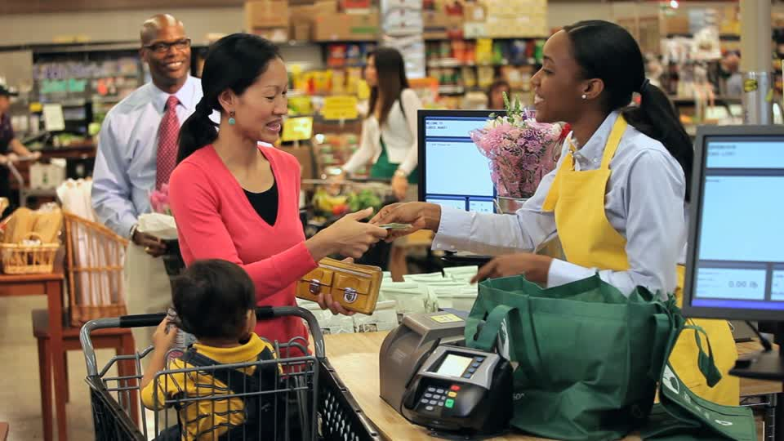
Actors
An actor is a role played by the user or an external entity during interaction with the system
Who or what uses the system
Actors communicate with the system by sending and receiving messages
Example
Develop a system of cash register at the supermarket
Possible actors
Client
Cashier
Manager
Inventory manager

Slide 45
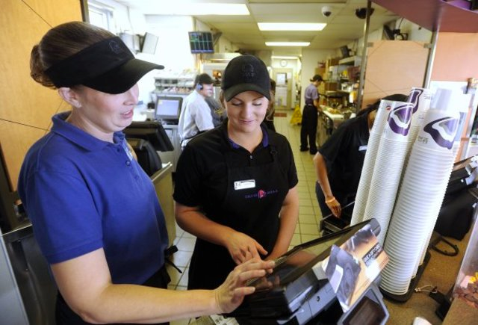
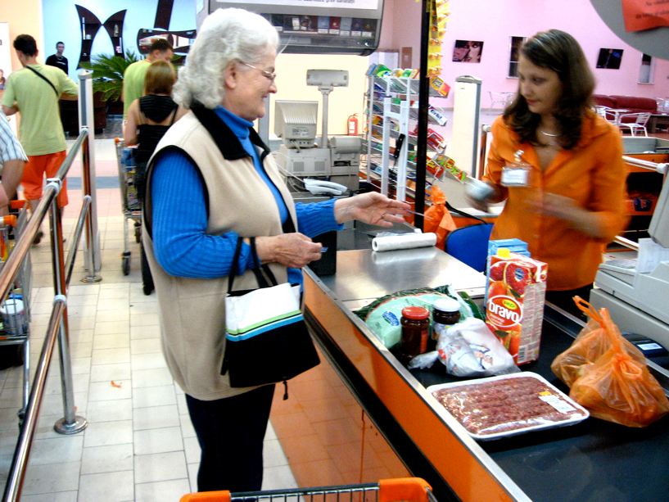
Actors
Distinguishing two notions: actor and user
Multiple users may correspond to a single actor
Different cashiers play the same role in the system
A user may correspond to several actors
A user can simultaneously be a cashier and a manager in the system
cashier and manager
cashier and customer

Slide 46

Actors
Questions for identifying the system actors
Who will use the main features of the system?
Who will need the support of the system to perform its tasks?
Who should update, administer and maintain the system?
Does the system interacts with other systems?
Who or what has interests on the results of the system?
Cash register of supermarket
identification
Cashier
purchase
refund
Customer
Manager
label products

Slide 47
Relations between the actors
Inheritance between actors
Client
Individual
Enterprise

Slide 48
Use-case specification
Typical specification of a use-case
Use-case: name of a use-case often begins with a verb
Actors: list of stakeholders concerning the use-case
Objective: objective of the use-case
Description: a brief description of treatment to achieve
Example
Use-case: purchase products
Actors: Client, Cashier
Objective: describe a purchase of products by the customer with cash payment
Description: The client comes in the box with the selected products. The cashier encodes products, announces the total. The customer pays. The cashier registers the payment.

Slide 49
Use-case specification
The use-case specification may add
the references concerning the specification of the requirement
the pre- and post-conditions of the use-case
Example
Use-case: purchase products
Actors: Client, Cashier
Objective: describe a purchase of products by the customer with cash payment
References: R1.2, R3.4
Pre-conditions: the cashier is identified and authorised
Post-conditions: the purchase is registered, the payment is made, the receipt is printed
Description: The clients comes in the box with the selected products. The cashier encodes products, announces the total. The customer pays. The cashier registers the payments.

Slide 50
Use-case specification
A use-case can be specified by adding scenarios
A scenario describes the specific actions of the actors in the system
A scenario consists of main interactions and exceptional interactions
The actions can be divided into two flows
Flow of actions concerning the actors
Flow of actions concerning the systems
Example
A scenario for “purchase products” use-case

Slide 51
Use-case specification
Main interactions of “purchase products” scenario
Actions of actor | Actions of system
1. The customer comes to the cash desk with the products to buy
2. The cashier encodes the identifier of each product If a product has more than one item, the cashier inputs the number of items | 3. The cash desk displays the description and price of the product This number is displayed
4. After having encoded all of the products, the cashier signals the end of the purchase | 5. The cash desk calculates and displays the total amount that the customer has to pay
6. The cashier announces the total amount to the customer
7. The customer pays
8. The cashier input the amount of money paid by the customer | 9. The cash desk displays the balance

Slide 52
Use-case specification
Main interactions of “purchase products” scenario (continue)
Exceptional interactions of “purchase products” scenario
Actions of actor | Actions of system
 | 10. The cash desk prints the receipt
11. The cashier gives change to the customer and the receipt | 12. The cash desk saves the purchase
13. The customer leaves the cash desk with the bought products
Actions of actor | Actions of system
7. The customer doesn’t have enough money. The cashier cancel the purchase | 3. The product identifier is not correct, the system displays the error

Slide 53
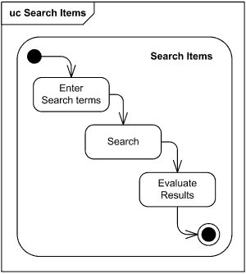
Use-case specification
Remarks
The use-case’s specification format is only a proposal. Therefore, it is not strict
The interactions are described in more detail for important use-cases
Use-case’s interaction can also be described using activity diagram, state diagram or interaction diagram
Use-case’s interactions described in activity diagram

Slide 54
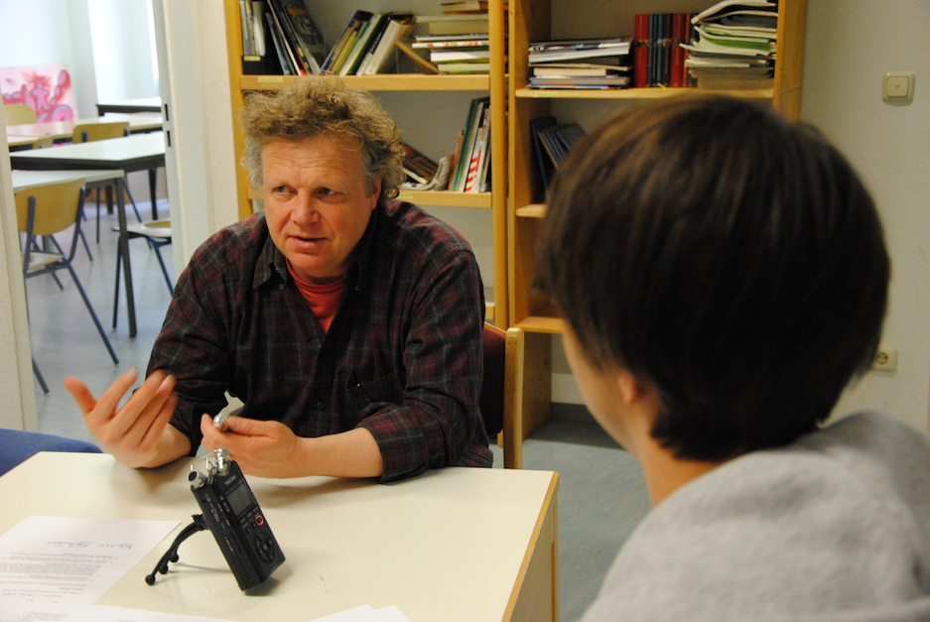
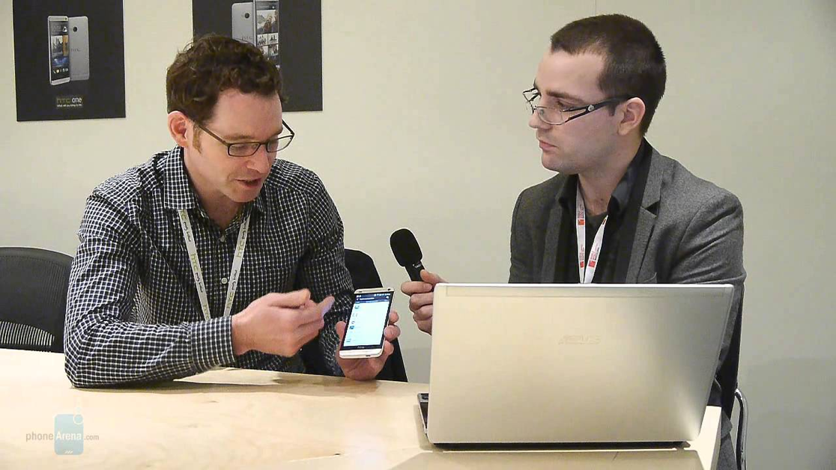
Use-cases identification techniques
Software Developer write requirements specification themselves
Lack of human reactions (future users of the system)
Interview
User interview
User interview

Slide 55

Use-cases identification techniques
Workshop (Organise meetings)
Meeting of all the concerned people of the system to be developed
Customers, Users, Software developers
Everyone gives their ideas
List all the possible actors, use-cases
Analyse and describe briefly each use-case
Model the use-cases and actors
Remarks
Don’t try to search for all the use-cases
Other use-cases can appear in the development process
Workshop

Slide 56
Relationships between use-cases
Two types of relationship between use-cases
Extension
Inclusion
“extension” relationship
Used to specify the optional interactions
These are exceptional cases
The case where a use-case is similar to another but it includes additional actions
The extending use-case must list all the actions in the main use-case and also the supplementary actions

Slide 57
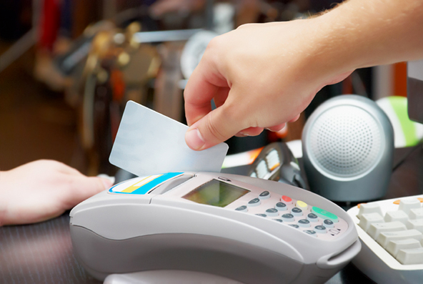
Relationships between use-cases
“extension” relationship
Example: “purchase product with payment by credit card” use-case
Use-case: purchase products
Actors: Customer, Cashier
Objective: describe a purchase of
products by the customer with
payment by credit card
Description: The customer comes
to checkout with selected products.
The cashier encodes products, announces the total amount. The customer gives his credit card. The cashier inserts the credit card into the system. The customer types the PIN code. The system verifies the card and then deducts the total of the card.
This use-case is a variation of the “purchase products” use-case but adds actions relating to the use of credit card.

Slide 58
Relationships between use-cases
“extension” relationship
“Purchase products with credit card payment” use-case is an extension of the “Purchase products” use-case
Notation
Remarks: If a use-case is associated with an actor, all extensions are also associated with this actor. This is expressed implicitly in the use-case diagrams.
<< extends >>
Purchase products with
credit card payment
Purchase products
extension

Slide 59
Relationships between use-cases
“inclusion” relationship
describes a series of joint actions in several cases of different usages
if several use-cases share the same sequence of actions and this common part is intended to meet a clearly defined goal then the part is described in a separate use-case
helps to avoid repeating the same details in different use-cases

Slide 60
Relationships between use-cases
Example of “inclusion” relationship
Suppose we have two use-cases “purchase product” and “purchase products with credit card payment”
Both use-cases have the same sequence of actions of encoding products that can be described by the “encode products” use-case
Actions of actor | Actions of system
The customer comes to the cash desk with the products to buy
The cashier encodes the identifier of each product If a product has more than one item, the cashier inputs the number of items | The cash desk displays the description and price of the product This number is displayed
After having encoded all of the products, the cashier signals the end of the purchase | The cash desk calculates and displays the total amount that the customer has to pay
The cashier announces the total amount to the customer
actions of encoding products

Slide 61
Relationships between use-cases
“inclusion” relationship
Example (continue)
“encode products” use-case
Use-case: encode products
Actor: Customer, Cashier
Objective: describe the encoding of the products bought by a customer
Description: The customer comes to checkout with the selected products. The cashier encodes products, announces the total amount to the customer.
Notation
Purchase products
<< includes >>
Encode products
<< includes >>
Purchase products with
credit card payment
inclusion

Slide 62
Building use-case diagrams
A use-case diagram describes the relationships between the use-cases and actors of the system
The steps to build a use-case diagram
Define the limits of the system
Identify the actors
Identify the use-cases
Define the relationships between use-cases
Verify the diagrams
Cash register of supermarket
identification
Cashier
purchase
refund
Customer
Manager
label products

Slide 63
Classification of use-cases
Assign the use-cases to iterations of development process
How to assign use-cases to iterations of development process?
Use-cases should be implemented in the order of importance. For example:
Use-cases that may contain risks
Use-cases that build the architecture of the software
Use-cases that realise a large part of the system functionality
Use-cases that require new technology or significant research
Use-cases that have great interests by the customer
iteration 1
iteration 2
cycle 3
…
A
B
D
C
Use-case

Slide 64
Example
An automated teller machine (ATM) is a banking subsystem that provides bank customers with access to financial transactions in a public space without the need for a cashier, clerk, or bank teller.
Customer uses bank/VISA ATM to Check Balances of his/her bank accounts, Deposit Funds, Withdraw Cash and/or put money
On most bank ATMs, the customer is authenticated by inserting a plastic ATM card and entering a personal identification number (PIN).
Operator need to regularly put money into the machine, get checks, get cards
Identify actors, use cases, and use case diagrams

Slide 65
Example
Actors
Bankcard (Người có thẻ ngân hàng )
VISAcard (Người có thẻ VISA)
Operator (Người vận hành máy)
VISA (Hệ thống VISA)
Bank (Hệ thống thông tin ngân hàng)

Slide 66
Example
Use-cases
withdraw by bankcard (Rút tiền với thẻ ngân hàng)
withdraw by VISAcard (Rút tiền với thẻ VISA)
Identify (Kiểm tra mã PIN)
Balance (Xem số tiền còn trong tài khoản )
Deposit (Bỏ tiền vào tài khoản bằng ngân phiếu hoặc tiền mặt )
put money (Nạp tiền vào máy )
get cards (Lấy thẻ bị nuốt trong máy )
get checks (Lấy ngân phiếu trong máy )

Slide 67
Example
withdraw with VISA card
VISAcard
VISA
withdraw with bank card
balance
bankcard
deposit
bank
<<includes>>
<<extends>>
identify
deposit by check
deposit by cash

Slide 68
Example
put cash
get cards
operator
get checks

Slide 69
Project
Divide groups of 4-5 students
Each group chooses a problem
Guide students through the steps of project
Describe the problem requirement

Slide 70
Project (2)
Divide groups of 4-5 students
Each group chooses a problem
Building use case diagrams: Choose one of the following tools:
Microsoft Visio (2007 -2016)
StarUML: http://staruml.io/
Argo UML: https://argouml.jaleco.com/
Lucidchart: https://www.lucidchart.com/pages/examples/uml_diagram_tool

